Slide 1
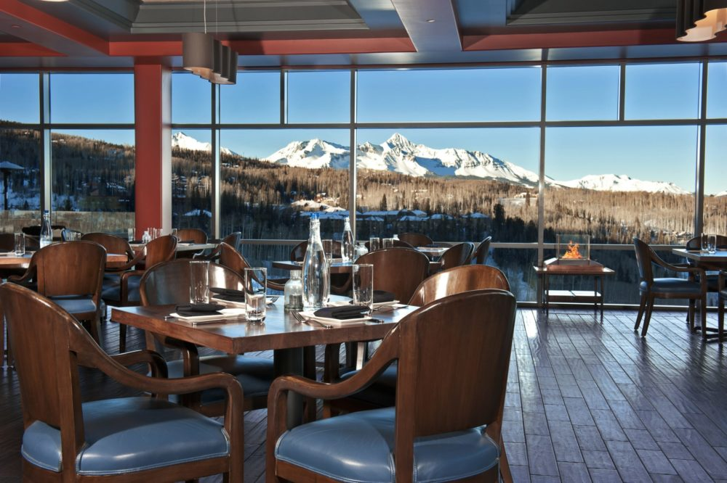
THE FOODIES
Marie Bourne, Hanna Huseva, Habib Khan, Nenye

Slide 2
SCOPE OF WORK
The Foodies App is designed to help users narrow down restaurants and food options based on location and budget.
The user is asked to enter the following variables:
In which city they want to search for restaurants/food in?
How far they are willing to travel?
Type of food they are hungry for?
How broke are they?

Slide 3
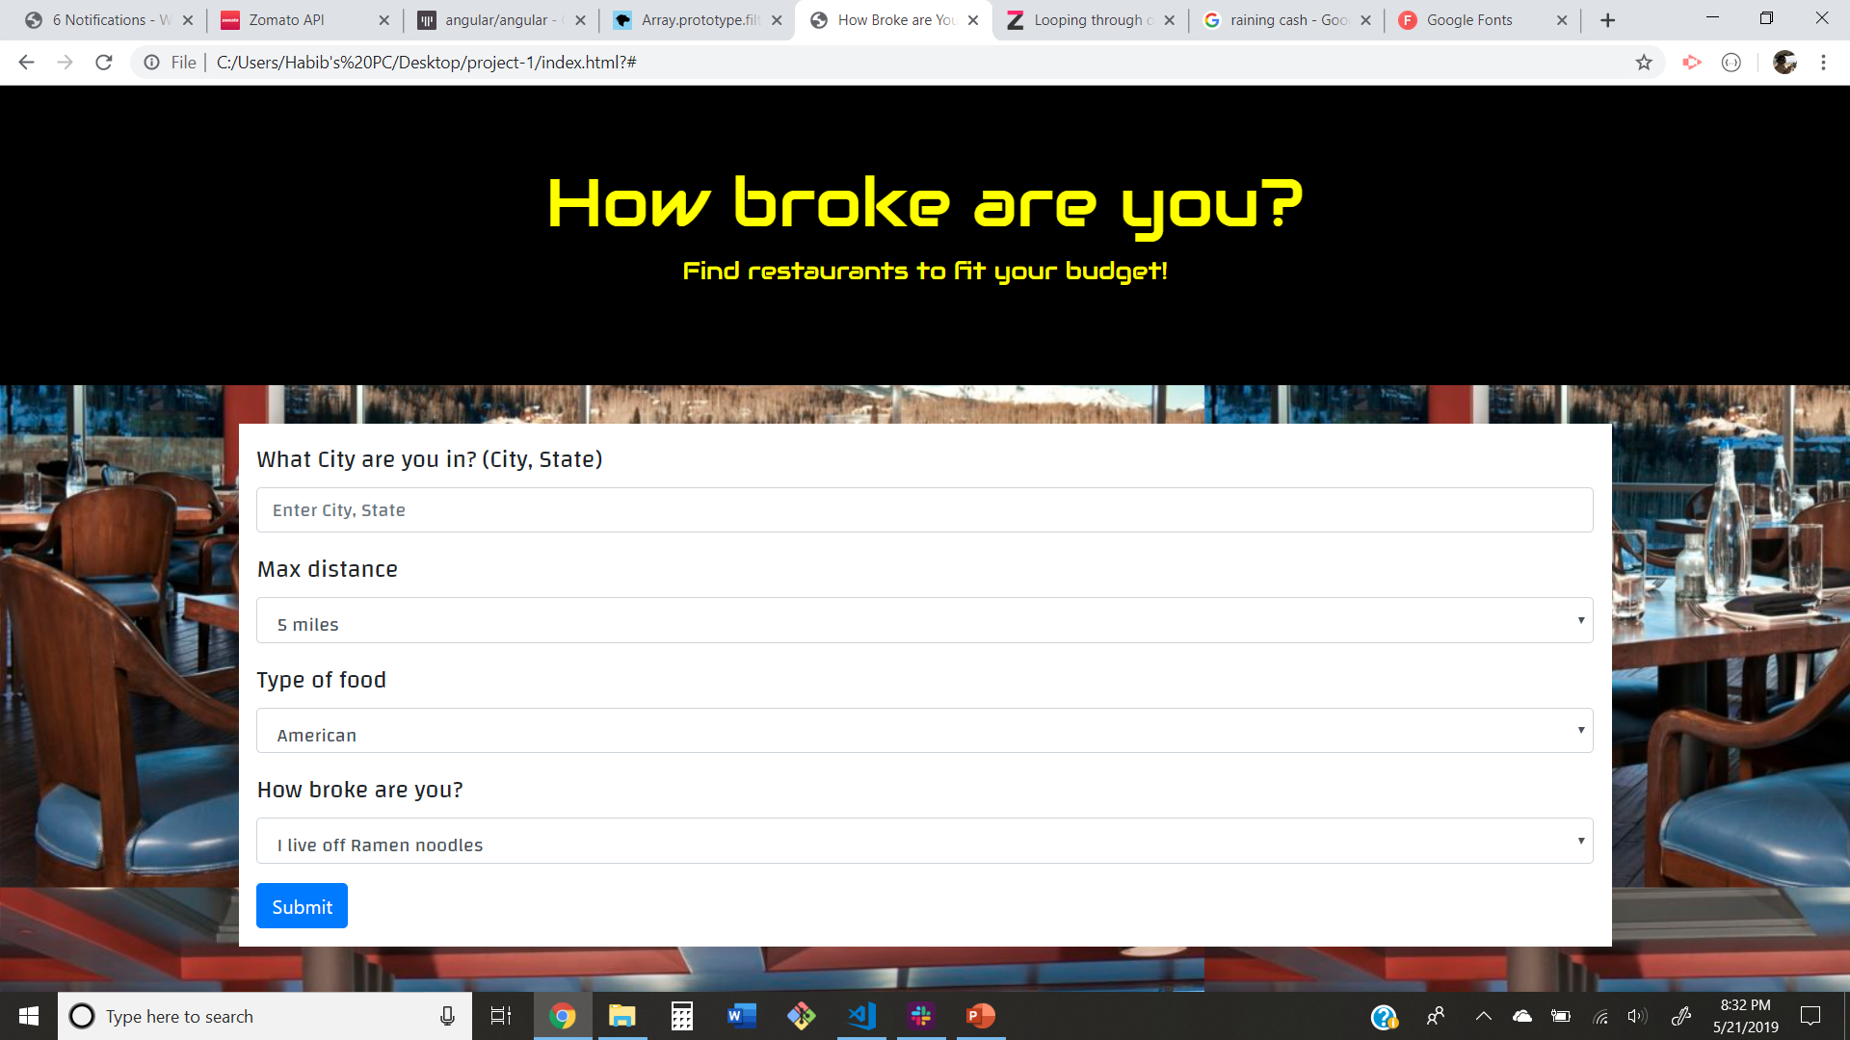

Slide 4
RESULTS PAGE
The results page will return back (10) restaurants which meet the users requirements
The results card includes:
Name of restaurant
Restaurant Address
A link back to the restaurants home page
Along with the restaurant results, (10) random gifs of the type of cuisine chosen will appear along the side

